Slide 1
WE YON MAMA
CATERING TO THE WELFARE OF WOMEN

Slide 2
OUTLINE
PROBLEM STATEMENT
THE SOLUTION
HOW IT WORKS
CORE FEATURES
TARGET AUDIENCE
IMPACTS & BENEFIT
MISSION
USSID MODEL
WEBPAGE MODEL
CONTACT US

Slide 3
PROBLEM STATEMENT
Barriers: Lack of health education in schools and communities.
Cultural taboos prevent open discussions about sexual health. Lack of comfort reaching out to family for advice.
Consequences: Misinformation about health risks, including STDs and contraception. Emotional distress due to lack of support. Poor decision-making around sexual health and relationships.
In Sierra Leone, many young women and teenagers face significant challenges accessing reliable, accurate, and private information regarding their sexual health, relationships, and overall personal well-being. This lack of access affects their ability to make informed decisions and can impact their long-term physical and emotional health.

Slide 4
SOLUTION
What We Offer:
Sexual Health: Information on sexual and reproductive health, including sexually transmitted diseases (STDs), ovulation cycles, and contraceptive options.
Personal Advice: Accessible support for users to ask any questions they may be uncomfortable discussing elsewhere.
Safe Practices: Guidance on safe health practices, medication advice, and overall well-being tips.
Relationship Support: Relationship advice covering both personal and family dynamics, helping users navigate relationships with healthy boundaries and better communication.
Introducing We Yon Mama; We Yon Mama is a digital platform designed to be a trusted, confidential source of guidance and information for young women and teenagers in Sierra Leone.
By addressing their unique health and relationship needs, We Yon Mama aims to fill the critical gap in accessible sexual health education, personal advice, and emotional support in a culturally sensitive manner.
Our platform offers reliable, private information that young women can depend on, fostering empowerment and healthier choices.

Slide 5
How it works
USSD Service (*136#):
For users without internet access, We Yon Mama offers a USSD option to access essential information through simple, guided menus. With a short code (*136#), users can explore topics, ask questions, and receive answers quickly on any mobile device, ensuring accessibility regardless of location or connectivity.
Web Platform:
Designed with a user-friendly interface and soft, welcoming colors, the We Yon Mama website provides a more detailed and interactive experience for users with internet access. From browsing articles to submitting questions and scheduling calls, users can explore the platform’s offerings at their own pace, with visuals and navigation similar to trusted health websites like Red Cross.

Slide 6
Core feautures
Web Platform:
Easy-to-navigate interface.
Articles, resources, and expert advice on sexual health, relationships, and emotional well-being.
Judgment-free space for women to engage and ask questions
USSD Service (*136#):
Accessible on basic phones.Provides
essential information on:
Sexual Health
Medicines & Safe Practices
Relationship Advice
Risk (Understanding health risks, safe sexual practices, etc.)
Talk to a Counselor (Confidential support).
Schedule a Call (Personal consultations).

Slide 7



TARGET AUDIENCFE
Primary Audience: Teenagers & Young Adults (ages 13-25): Especially those without parental support or guidance.
Women in Rural Areas: With limited access to healthcare and sexual health information.
Women Facing Cultural Barriers: Who are hesitant to seek advice due to cultural norms or lack of comfort talking to family members.
Secondary Audience: Young mothers: Seeking information on sexual health and safe practices.
Healthcare professionals: Looking for resources to share with young patients in need of sexual health advice.

Slide 8
Impacts& Benefits
Confidentiality:
Safe Space: Women can ask sensitive questions without judgment.
Privacy: All interactions are confidential.
Accessibility:
USSD: Works on basic phones, no internet needed.
Web Access: For women with smartphones or internet access.
Expert Advice:
Qualified Counselors and Health Professionals ready to provide support.
Empowerment: Women can make informed decisions about their sexual health and relationships.

Slide 9
MISSSION
We Yon Mama aims to:
Educate: Empower women with essential knowledge about their health and relationships.
Support: Provide emotional and mental support through counseling and personalized advice.
Break Barriers: Overcome the taboos and barriers surrounding discussions about sexual health in Sierra Leone.
Goal:
To ensure every woman in Sierra Leone has access to the information, resources, and support she needs to make informed, safe decisions about her body and relationships.

Slide 10
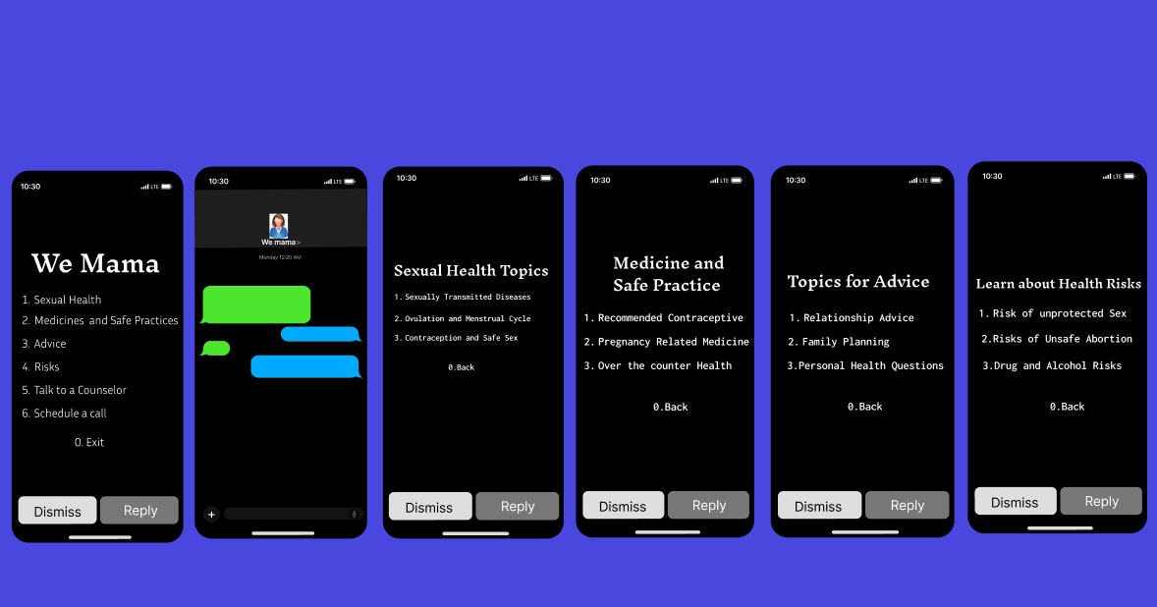
USSID MODEL

Slide 11
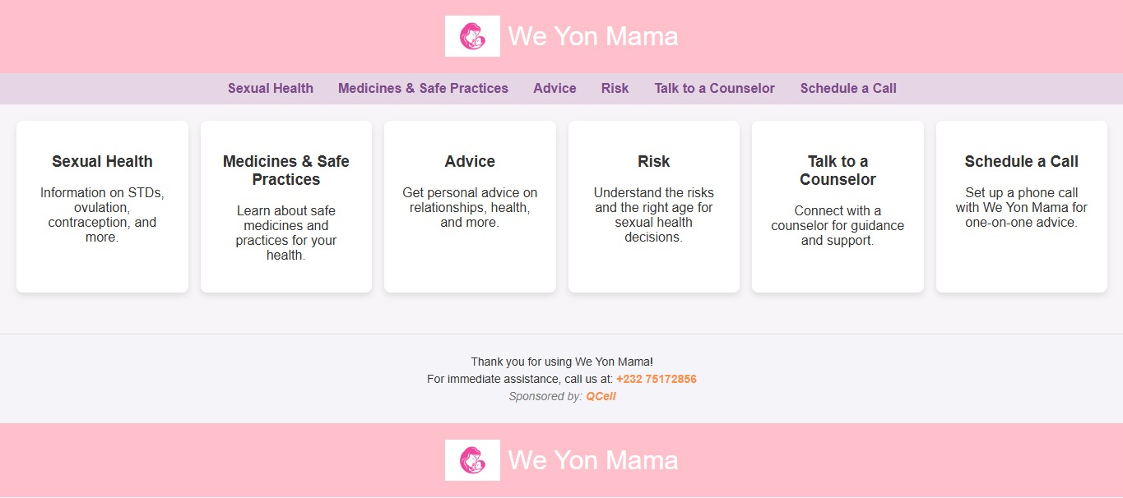
WEBPAGE MODEL

Slide 12
Contact Us
EmaiL.com
jallohrugishma01@gmail
thelmaakanu2021@gmail.com
Phone +23275172856
+232 76742116

